Slide 1


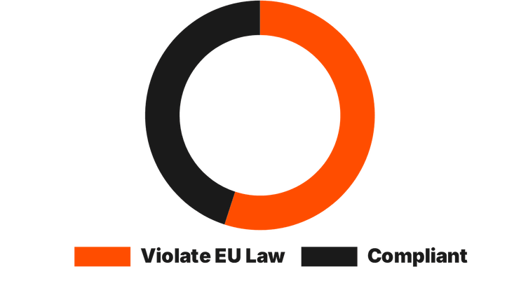
TruePartner: Driving Transparency in Car-as-a-Service (CaaS)
TRANSPARENCY GAP
THE TRUEPARTNER SOLUTION
Hidden costs, unclear policies
Specialized EV Management
Dedicated platform for managing EV rentals with specific pick-up and drop-off logistics designed for the electric future.
Integrated Community Rating
Individuals and organizations can rate services to maintain accountability and ensure long-term trust in the ecosystem.
Role-Based User Access
Separate interfaces for fleet administrators and customers/organizations for streamlined booking and management.
55%
of rental broker websites violate EU law.
Target audience
Customers on 21 years old or above

